Slide 1

Digital Design and Verification Training
Introduction to Tcl

Slide 2
Agenda
Introduction to TCL
Brief history and purpose
Why TCL is important for digital design
TCL Basics
Syntax overview, Variables and data types, Control structures (if, while, for), Procedures
TCL in Digital Design
Advanced TCL Concepts
Practical Examples

Slide 3
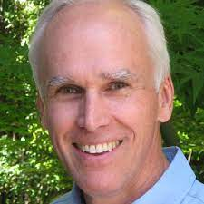
Introduction to TCL
Brief History and Purpose
Created by John Ousterhout in 1988
TCL stands for Tool Command Language
Purpose:
Provide a simple, extensible scripting language
Easy to integrate into C/C++ applications
Cross-platform compatibility
Rapid prototyping and development

Slide 4
Why TCL is Important for Digital Design
Widely adopted in Electronic Design Automation (EDA) tools
Synopsys, Vivado, Cadence, Mentor Graphics all support TCL
Enables automation of repetitive tasks in design flows
Provides a consistent interface across different tools
Allows customization of design environments

Slide 5
Why TCL is Important for Digital Design
Supports creation of complex design flows and methodologies
Enables scripting of design rule checks and constraints
Facilitates generation of design and verification reports
Used throughout the design process, RTL design and synthesis, Place and route. Timing analysis, Power analysis, Verification and simulation
Enables creation of unified design environments
Facilitates data exchange between different design stages

Slide 6
TCL Basics
Syntax Overview
Commands are space-separated words
First word is the command, rest are arguments
Semicolons separate multiple commands on one line
Brackets [] for command substitution
Braces {} for grouping and deferring evaluation
Dollar sign $ for variable substitution
Backslash \ for line continuation and special characters
Comments start with #

Slide 7
TCL Basics
Variables:
No declaration needed
Created on first use
set command for assignment: set varName value
Access with $varName
Special variables:
env (environment variables)
argc, argv (command-line arguments)

Slide 8
TCL Basics
Control Structures
if-else:
While loop:
For loop:
if {condition} { # code block } elseif {condition} { # code block } else { # code block }
while {condition} { # code block }
for {initialization} {condition} {increment} { # code block }

Slide 9
TCL Basics
Procedures
Defined using the proc command
Syntax:
Local variables with set command inside procedure
global command to access global variable.
Return value is the result of the last command (or explicit return)
proc procedureName {arg1 arg2 ...} { # procedure body return $result }

Slide 10
TCL Basics
To enter
tclsh
To exit
exit
Command Syntax
command variable value; #comment
Command value
Path of tclsh
which tclsh (Use this with shebang at start of tcl file)
To run a tcl file
tclsh ./<file_name>.tcl

Slide 11
TCL Basics
% puts hello
hello
% puts "hello"
hello
% puts 1 1
% puts hello there
Error
% puts "hello there"
hello there
% puts "\n"​ ​
% puts {\n}​
\n​
% puts hello; puts 1​
hello​
1
% puts hello #comment
Error
% puts hello; #comment
hello

Slide 12
TCL Basics
% set x 1 1
% set y hello
hello
% set z "hi"
hi % puts $x 1
% expr $x + 1​
2​
% set x [expr $x+1]​ 2​
% puts $x​
2

Slide 13
Conditionals and While Loop
Space between each closing and next opening of curly braces is compulsory.
Starting curly brace of statement should be in the same line as conditional.
% set x 1​ 1​ % if {$x == 1} {puts "x is 1"} else {puts "x is not 1"}​
x is 1​
% while {$x < 6} {​set x [expr $x+1]; puts $x}​
1​
2​
3​
4​
5​
6

Slide 14
For Loop
Syntax:
for start test next command
% for {set i 0} {$i <2} {incr i} {puts hello} hello
hello % for {set i 0} {$i <2} {incr i; puts $i} {puts hello} hello
1
hello
2

Slide 15
File I/O
Opening files:
Reading from files:
gets $fileHandle line
read $fileHandle
Writing to files:
puts $fileHandle "data"
Closing files:
close $fileHandle
set fileHandle [open "filename.txt" r] # r for read, w for write, a for append

Slide 16
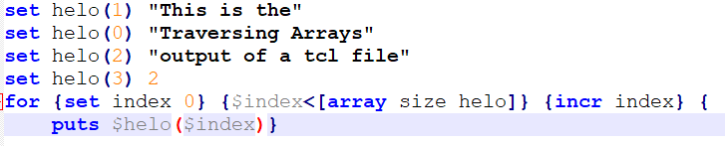
Arrays
Array declaration:
set name(index) value
Use for loops for traversing arrays
Commands:
Output:
Traversing Arrays​
This is the​
output of a tcl file​
2

Slide 17
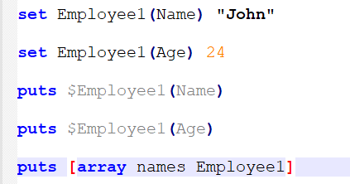
Associative Arrays
Associative arrays are unordered set of values which can be accessed via corresponding keys/ index value which may not be a number.
Retrieving keys/indexes of an array: array names <array-name>
Commands:
Output:
John 24 Age Name

Slide 18
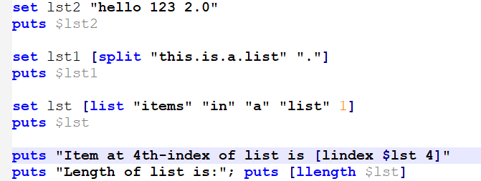
Lists
Ordered collection of numbers, words, strings or other lists.
Command for getting value of an item at an index: lindex $<list-name> index
Command for total number of items in a list: llength $<list-name>
Use foreach to iterate over list items.
Commands:
Output:
this is a list
items in a list 1
Item at 4th-index of list is 1
Length of list is:
5

Slide 19
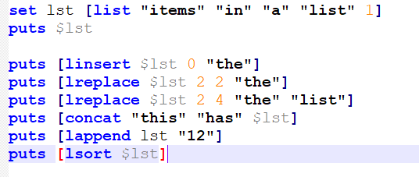
Lists
Commands:
Output:
items in a list 1
the items in a list 1
items in the list 1
items in the list
this has items in a list 1
items in a list 1 12
1 12 a in items list

Slide 20
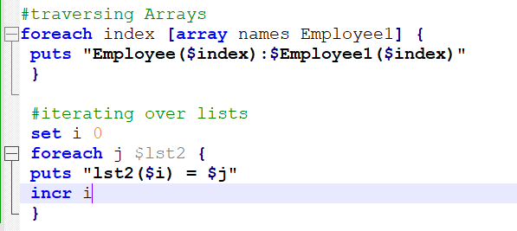
Foreach Loop
For traversing associative arrays
For iterating over items in a list
Commands:
Output:
Employee(Age):24
Employee(Name):John
lst2(0) = hello
lst2(1) = 123
lst2(2) = 2.0

Slide 21
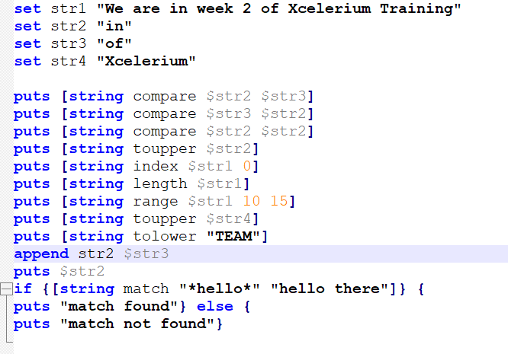
Working with Strings
Commands:
Output:
-1
1
0
IN
W
38
week 2
XCELERIUM
team
inof
match found

Slide 22
Practical Examples
# Example usage of the parse_verilog procedure set design_modules [parse_verilog "design.v"] puts "Modules found: $design_modules"
Example 01: Reading and Parsing Design Files
# This procedure parses a Verilog file to extract module names and their ports proc parse_verilog {filename} { set fh [open $filename r] # Open the file for reading set content [read $fh] # Read the entire file content close $fh set modules {} # Initialize an empty list to store module information foreach line [split $content "\n"] { # Iterate through each line of the file # Use regular expression to match module declarations. This regex captures the module name and its port list if {[regexp {module\s+(\w+)\s*\((.*?)\);} $line -> name ports]} { # Add the module name and its ports (split into a list) to our modules list lappend modules [list $name [split $ports ,]] } } return $modules }

Slide 23
Practical Examples
# Example usage, Generate the timing summary report generate_timing_summary
# This procedure generates a timing summary report proc generate_timing_summary {} { set report_file "timing_summary.rpt" # Define the output report file name set fh [open $report_file w] # Open the file for writing puts $fh "Timing Summary Report" puts $fh "=====================" # Write the report header set wns [get_attribute [get_timing_paths -max_paths 1 -nworst 1] slack] puts $fh "Worst Negative Slack: $wns" # Get and write the Worst Negative Slack (WNS) set tns [get_attribute [get_timing_paths -max_paths 1 -nworst 1] tns] puts $fh "Total Negative Slack: $tns" # Get and write the Total Negative Slack (TNS) puts $fh "\nTop 5 Violating Paths:" # Write details of the top 5 violating paths foreach_in_collection path [get_timing_paths -max_paths 5 -nworst 1] { puts $fh [get_object_name $path] puts $fh " Slack: [get_attribute $path slack]" } close $fh puts "Report generated: $report_file" } # Close the report file

Slide 24
Practical Examples
# Run optimization for max 10 iterations, targeting 0.0 slack optimize_timing 10 0.0
# This procedure performs timing-driven optimization proc optimize_timing {max_iterations target_slack} { # Loop for a maximum number of iterations for {set i 0} {$i < $max_iterations} {incr i} { puts "Optimization iteration $i" optimize_design -dynamic # Run dynamic optimization (tool-specific command) set wns [get_attribute [get_timing_paths -max_paths 1 -nworst 1] slack] # Get the current Worst Negative Slack (WNS) puts "Current WNS: $wns" # Check if we've met our target slack if {$wns >= $target_slack} { puts "Target slack met. Exiting optimization loop." break } } # Check if we exited due to reaching max iterations if {$i == $max_iterations} { puts "Warning: Max iterations reached without meeting target slack." } }

Slide 25
Sample TCL file
# Script to automate synthesis and reporting # Set up variables set design_name "my_design" set clock_period 10 set output_dir "./output" # Read in the design read_verilog design.v current_design $design_name # Set constraints create_clock -name "my_clock" -period $clock_period [get_ports clk] set_input_delay 0.5 -clock my_clock [all_inputs] set_output_delay 0.5 -clock my_clock [all_outputs] compile_ultra # Run synthesis (Tool specific procedure call) # Generate reports report_area > $output_dir/area_report.txt report_timing > $output_dir/timing_report.txt report_power > $output_dir/power_report.txt # Write out the synthesized design write -format verilog -hierarchy -output $output_dir/synth_$design_name.v puts "Synthesis complete. Output files are in $output_dir"

